Slide 1
Agro Analytics
Mohit Shah | 60004130094
Mihin Sumaria | 60004130110
Manan Shah | 60004148019
A Project on Data Mining and Analytics
Project Guide: Mrs. Lynette D’mello

Slide 2
Contents
> Problem Definition
> Need
> Scope
> Literature Review
> Workflow of Proposed System
> Technologies to be Used
> System Design for Classifiers and Expected / Observed Outcome
> Results of Classifier 1 and Classifier 2
> User Interface Design
> Future Scope and Conclusion

Slide 3
Problem Definition
The aim of the project is to analyze and then predict agricultural trends by suggesting optimal agricultural practices such as:
Suitable crops to be grown according to area;
Suitable crops to be grown according to seasons
Parameters to be used:
District-wise Monthly Rainfall from 2001 to 2016;
District-wise Monthly Average Temperature from 2001 to 2016;
District-wise Monthly Average Pressure from 2001 to 2016;

Slide 4
Need
Currently all statistics available are just raw data.
Does not give a definite relationship among the parameters stated above.
To find these relational trends, we need to implement knowledge discovery algorithms, to extrapolate the data over the past few years.
Since predicting these patterns manually, using traditional methods, has become extremely difficult, we have employed data mining techniques to do the same.
Keeping in mind the ongoing drought situation, said to be the worst in the past decade, the system will suggest effective measures to alleviate the current scenario in the state of Maharashtra.

Slide 5
Scope
Scope:
Farmers throughout the state (especially Vidarbha and drought-hit regions like Yavatmal, Gadchiroli etc.).
Government agricultural agencies, who can use the inferred data and convey to the farmers.
Can also be implemented in other states facing a similar situation (Eg. Uttar Pradesh, Madhya Pradesh).
For more accurate results, more parameters can also be added such as,
Usage of inputs - fertilizers, pesticides etc.
Soil fertility
Terrain

Slide 6
Literature Review
Use of large datasets of soil and weather for agricultural decision-making by making use of classifiers like Naïve Bayes and Random Forests. Decision-making is supplemented by the soil profiling and patterns observed in the given data.
Use of data of rural labour, arable land, and crop output for building a decision tree, and a set of spatial classification rules. Unsupervised cluster analysis of data followed by supervised decision tree classification is used here, to come up with a set of rules that can be used to generalize if some of the attributes are known.
Spatial data mining based on k-means clustering to analyse rainfall and temperature data for improvement of crop outputs.
Soil classification can be done using Naïve Bayes classifier, Decision Tree algorithms lie C4.5 and REP, on the basis of attributes like mineral content and water retention. Clustering can be used to find degree of dissimilarity or similarity among classified samples.
Use of density based clustering and multiple linear regression for estimation of crop production in the East Godavari District, using rainfall, land, fertilizers and crop output data.

Slide 7
Workflow of Proposed System
1. Prosperous Regions
2. Crop Growth
3. Rainfall
Mine Data from Available Repositories
START
Define Questions
Final Result Obtained?
STOP
Yes
Result Generation
Data Analyzing
No

Slide 8
Technologies Used
Python
Python Libraries:
Pandas - Python Data Analysis Libraries
NumPy
MatPlotLib
Seaborn
Scikit - Learn
BeautifulSoup

Slide 9
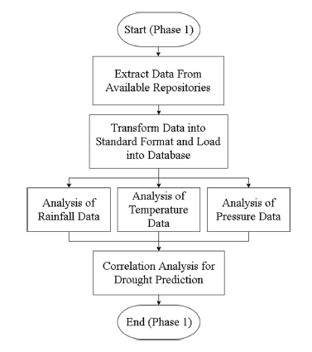
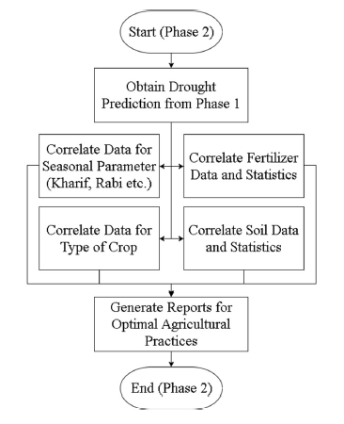
System Design for Classifiers

Slide 10
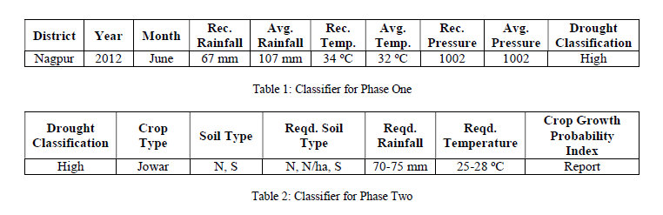
Expected / Observed Outcome

Slide 11
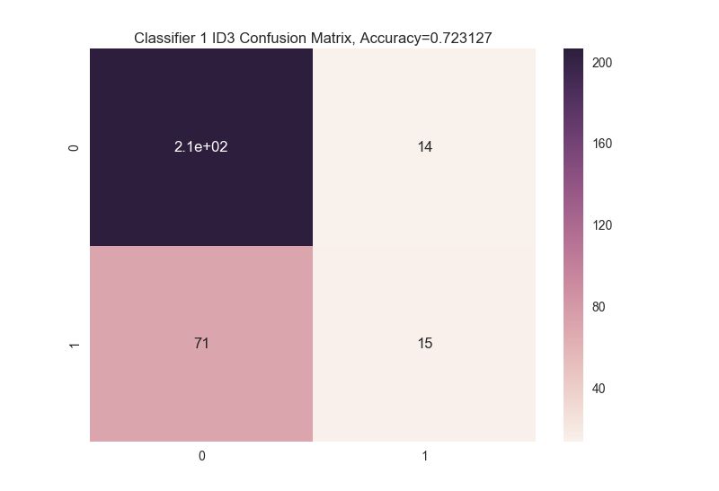

Results of Classifier 1 (All Data - Drough Classification)

Slide 12


Slide 13
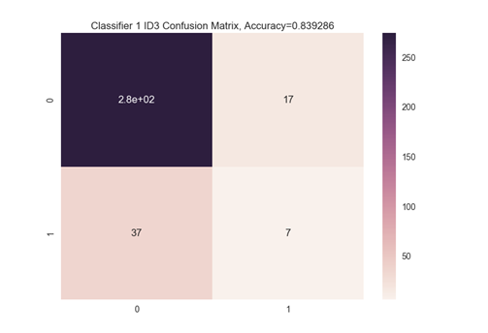
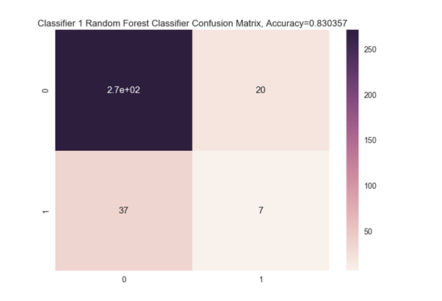
Results of Classifier 1 (Each District - Drought Classification)

Slide 14
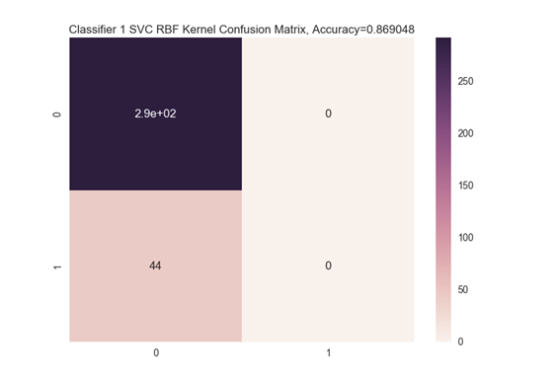
Results of Classifier 1 (Each District - Drought Classification)

Slide 15
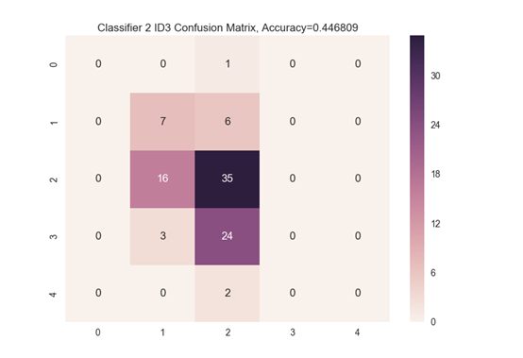
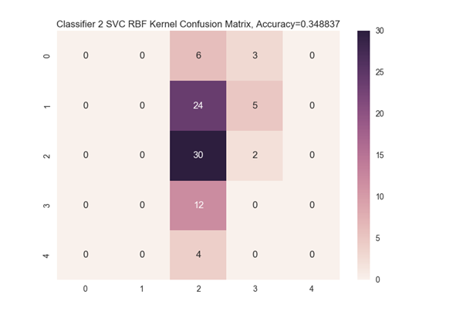
Results of Classifier 2 - Crop Growth
d
Sugarcane
Jowar

Slide 16

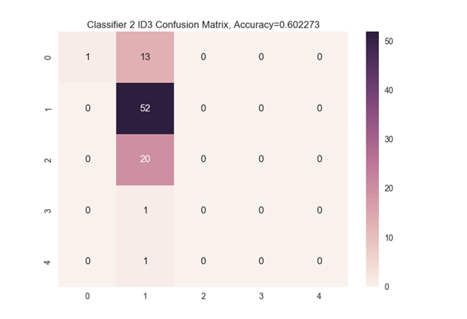
Results of Classifier 2 - Crop Growth
Bajra
Soyabean

Slide 17
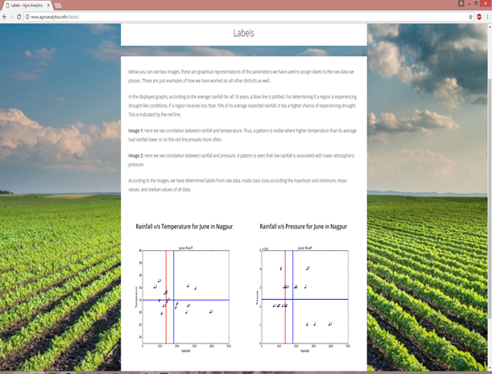
User Interface Design

Slide 18
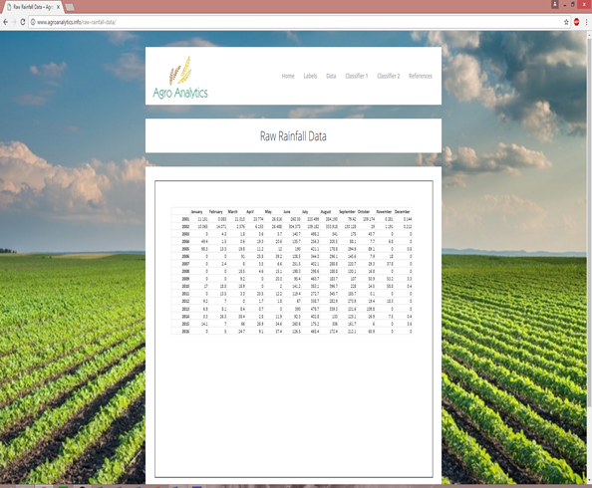

Slide 19
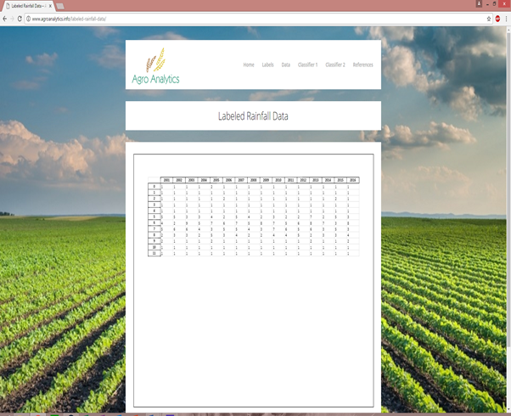

Slide 20
Future Scope
> Results can be improved with the addition of more attributes such as vapor pressure, soil nutrient data for minerals like Nitrogen, Phosphorous etc.
> Unsupervised techniques can be used for labeling of data to increase accuracy, based on cluster metrics such as Silhouette Score.
> Can be incorporated with existing Government Schemes like Soil Health Card.
> Can be implemented in more districts and states after successful implementation in Maharashtra.
> Data granularity can be increased for added precision.

Slide 21
Conclusion
This project highlights the application of machine learning and data mining algorithms in the field of agriculture. Crop productivity and drought predictions, if presented in a proper format to the end-users, the farmers, it will immensely help drought affected villages and districts. Decision making based on analytical models will complement traditional methods of farming. In our project, overall, Iterative Dichotomiser 3 algorithm proved to be most accurate in providing predictions for Classifier 1, also showed best results for the crop of Sugarcane in Classifier 2. Accuracy obtained upto 83.92% for Classifier 1 – Drought Classification, and upto 44.68% for Classifier 2 – Crop Productivity. These results can be further improved, and be used for future research, as well.

Slide 22
References
[3] G. Yi-Yang and R. Nan-ping, "Data Mining And Analysis Of Our Agriculture Based On The Decision Tree", International Colloquium on Computing, Communication, Control, and Management, pp. 134-138, 2009.
[6] R. Sujatha and P. Isakki, "A Study of Crop Yield Forecasting Using Classification Techniques", 2016 International Conference on Computing Technologies and Intelligent Data Engineering (ICCTIDE'16), Kovilpatti, pp. 1-4, 2016.
[7] D. Ramesh, "ANALYSIS OF CROP YIELD PREDICTION USING DATA MINING TECHNIQUES", International Journal of Research in Engineering and Technology, vol. 04, no. 01, pp. 470-473, 2015.
[9] H. Patel and D. Patel, "A Brief survey of Data Mining Techniques Applied to Agricultural Data", International Journal of Computer Applications, vol. 95, no. 9, pp. 6-8, 2014.

Slide 23
Thank You!

